Slide 1
SKENARIO
Scipy

Slide 2
TIM DATA SCIENCE
PERLU DIBUAT MODEL
Model untuk prediksi calon customer untuk program marketing selanjutnya
Terima report dari tim marketing
Dari report tersebut didaptkan masih gagal (88% tdk beli deposito)
Evaluasi
Tambahan :
Concern tim marketing di cost campaign
[PENTING] model digunakan sebelum melakukan campaign/program marketing
Kolom di dataset model yang dipakai adalah KOLOM YG BISA DIDAPATKAN Sebelum melakukan Campaign
!! INGAT !!
Calon customer yang di approach adalah nasabah bank tersebut

Slide 3
Analisis dilakukan di waktu jeda antar program
Mengacu pada jumlah minimal rekening nasabah premium
Gas masukin ke list calon customer
Model
Proba YA > 0.6
Data baru
!! INGAT !!
patokan di 500 jt rupiah/ 30,000 euro
Rekening >= patokan (SABI)
Rekening < Patokan (tidak sabi)
Sabi
0.6 >=Proba Ya >= 0.3
Lihat isi rekeningnya sabi ga
Tidak Sabi
Proba Ya < 0.3
JANGAN masukin ke list calon customer

Slide 4
Precision VS Recall

Slide 5
Precision diutamakan
Menghindari kerugian Cost Ketika Prediksi = YA tapi Aktual = TIDAK
Mengacu pada concern tim marketing
Campaign jadi lebih tepat sasaran
RESIKO
Recall kecil ➔ FN Tinggi → banyak yang prediksi = TIDAK tapi aktual = YA. → Potensial customer YA banyak yang menghilang

Slide 6
Mengatasi Resiko
Check orang-orang yang Probabilitas Ya nya di antara 0.3 – 0.6 berdasarkan Jumlah rekeningnya.

Slide 7
Urutan PPT
Tunjukin data set & casenya
Skenario
Business problem dan goals
EDA
Modelling
Simulasi
Conclusion

Slide 8
Dataset & Case
Dataset used was bank marketing campaign dataset from Kaggle (https://www.kaggle.com/volodymyrgavrysh/bank-marketing-campaigns-dataset)
Features Description
Bank client data:
Age (numerical continuous)
Job : type of job (categorical: "admin.","blue-collar","entrepreneur",...,"unknown")
Marital : marital status (categorical: "divorced","married","single","unknown")
Education : (categorical: "illiterate",...,"university.degree","unknown")
Default: has credit in default? (categorical: "no","yes","unknown")
Housing: has housing loan? (categorical: "no","yes","unknown")
Loan: has personal loan? (categorical: "no","yes","unknown")

Slide 9
Dataset & Case
Related with the last contact of the current campaign:
Contact: contact communication type (categorical: "cellular","telephone")
Month: last contact month of year (categorical: "jan", …, "nov", "dec")
Dayofweek: last contact day of the week (categorical: "mon","tue",...)
Duration: last contact duration, in seconds (numeric).
Important note: this attribute highly affects the output target (e.g., if duration=0 then y="no"). , Can not get this feature before the campaign
Other attributes:
Campaign: number of contacts performed during this campaign and for this client (numeric, includes last contact)
Important note: Can not get this feature before the campaign
Pdays: number of days that passed by after the client was last contacted from a previous campaign (numeric; 999 means client was not previously contacted)
Previous: number of contacts performed before this campaign and for this client (numeric)
Poutcome: outcome of the previous marketing campaign (categorical: "failure","nonexistent","success")

Slide 10
Dataset & Case
Social and economic context attributes
- Emp.var.rate: employment variation rate - quarterly indicator (numeric)
- Cons.price.idx: consumer price index - monthly indicator (changes in the price level of a weighted average market basket of consumer goods and services purchased by households, affect inflation (numeric))
- Cons.conf.idx: consumer confidence index - monthly indicator (degree of consumers optimism are expressing through their activities of savings and spending. affect consumer behavior (numeric))
- Euribor3m: euribor 3 month rate - daily indicator (Euribor (euro interbank offered rate) (numeric))
- Nr.employed: number of employees - quarterly indicator (Number of employed persons for a quarter (numeric))
Output variable (desired target):
- y - has the client subscribed a term deposit? (binary: "yes","no")

Slide 11
Scenario
We are data scientist team working at XYZ Bank in Portugal
The business development team came to us and told us that they needed improvement on marketing campaign result because the result was not good enough compared to the cost
They are asking if we can propose solutions to either reduce the cost or increase the income generated or both
They gave us customer dataset used at the recent campaign which consist of the bank’s customer data

Slide 12
Business Problems and Goals
Subscribe rate from the dataset is low (11.27%)
Cost expended was too big for the income generated
Dibutuhkan cara agar supaya bisa memfilter nasabah yang berpotensi dan yang tidak
GOALS
Memprediksi nasabah bank yang mungkin akan mengambil dposit atau tidak untk campaign berikutnya berdasrkan model dari yang sudah terjadi dengan menggunakan Machine Learning
Memberikan simulasi penurunan cost jika menggunakan Machine learningggggg

Slide 13
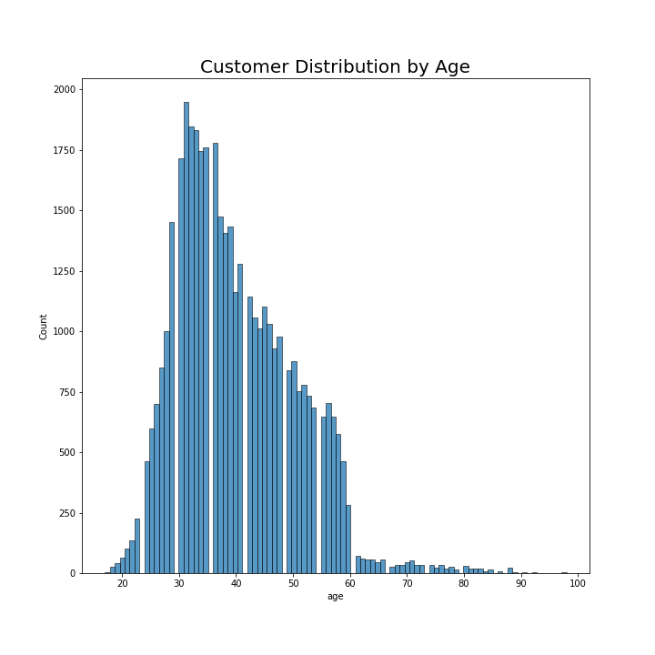
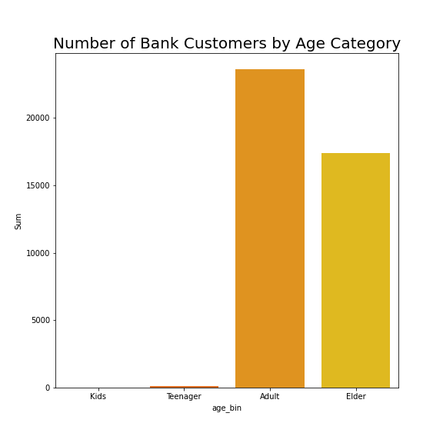
EDA - Univariate
Most customers were 25 to 60 years old
There is little to none customers in kids and teenager group

Slide 14
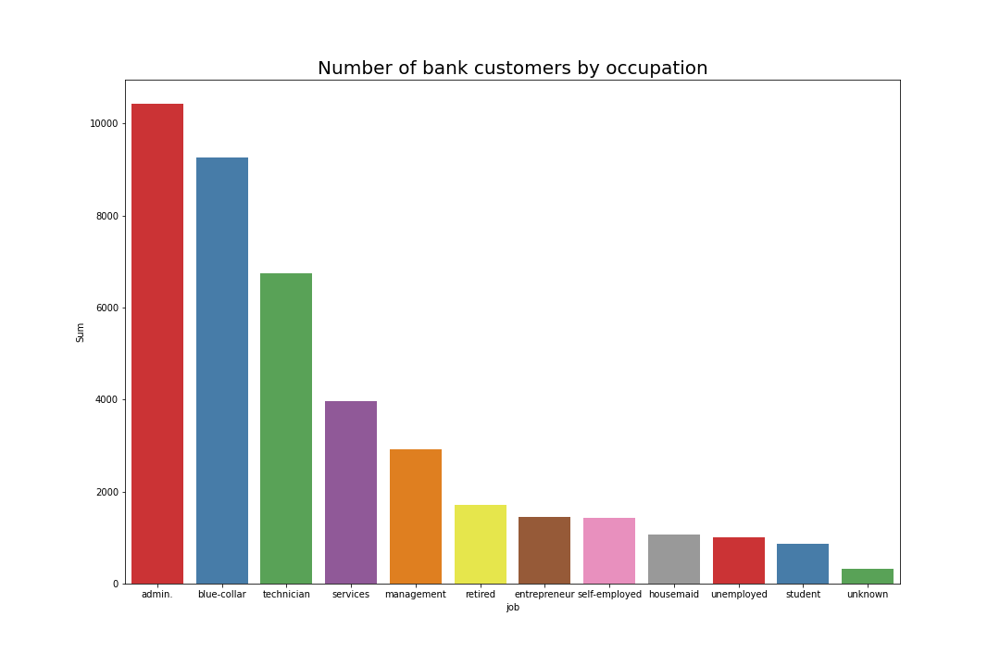
EDA – Univariate (2)
Most customers are working as admin, blue-collar, and technician

Slide 15
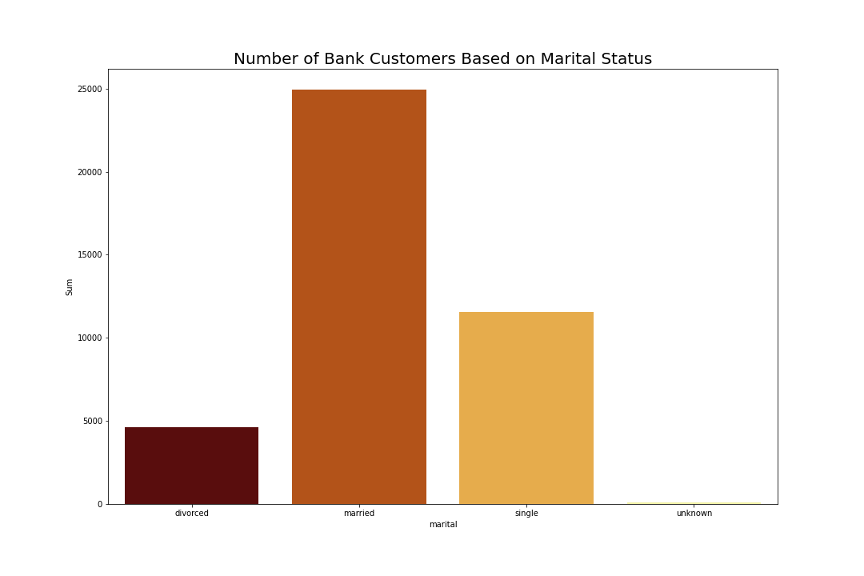
EDA – Univariate (3)
Most customers are married

Slide 16
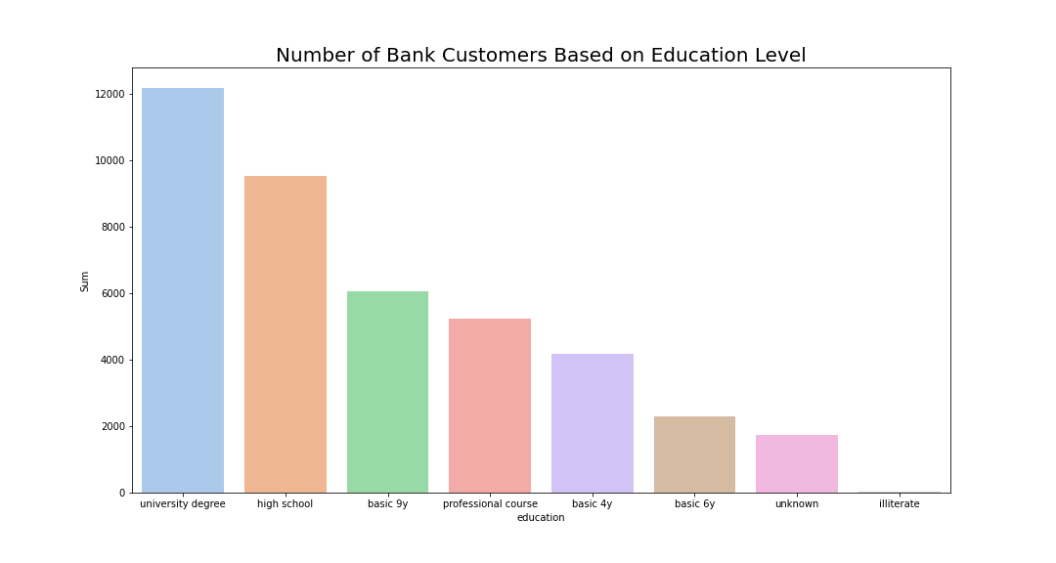
EDA – Univariate (4)
Most customers have university degree and high school education

Slide 17
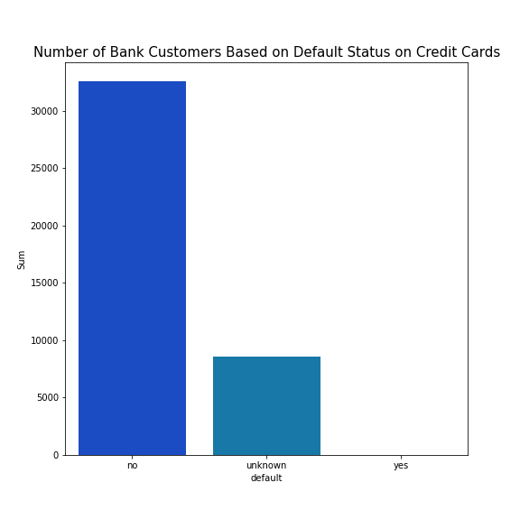
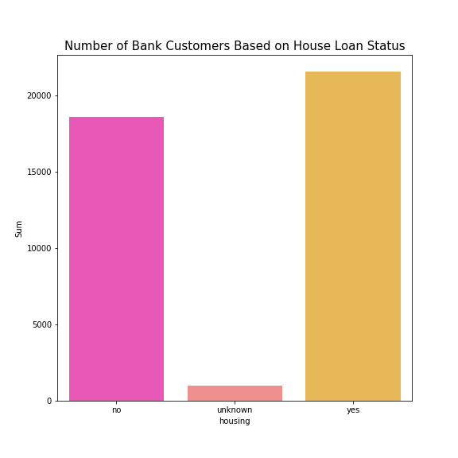
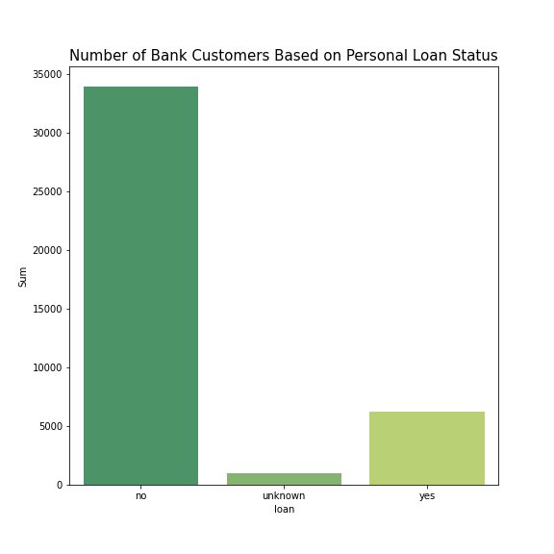
EDA – Univariate (5)
Most customers are not credit card default and has no personal loan
More than half of the customers have housing loan

Slide 18
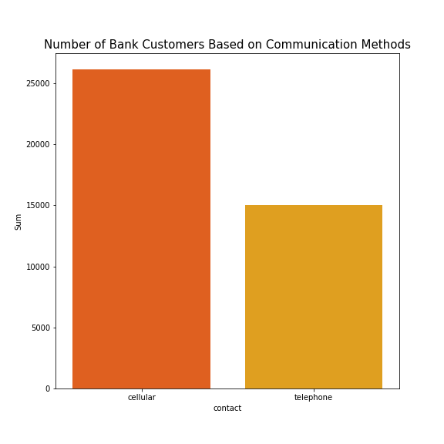
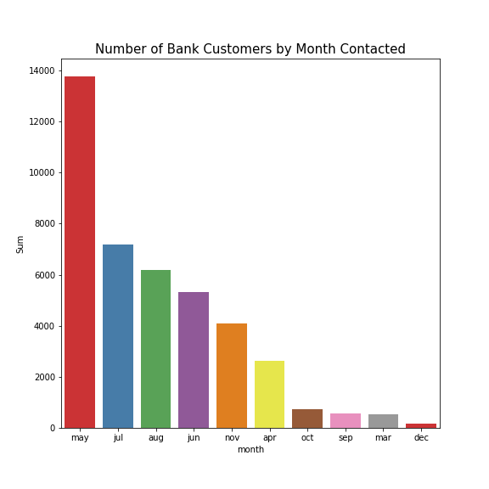
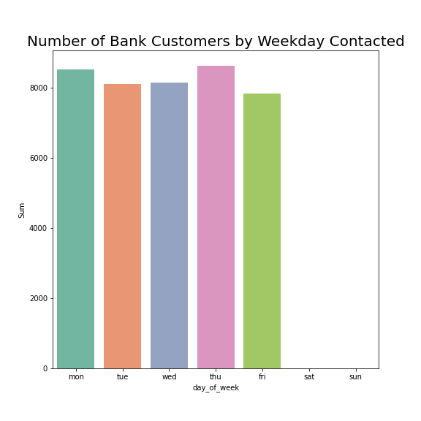
EDA – Univariate (6)
Most customers were contacted through their mobile phone
Most customers were contacted in May and all of them were contacted at weekdays

Slide 19
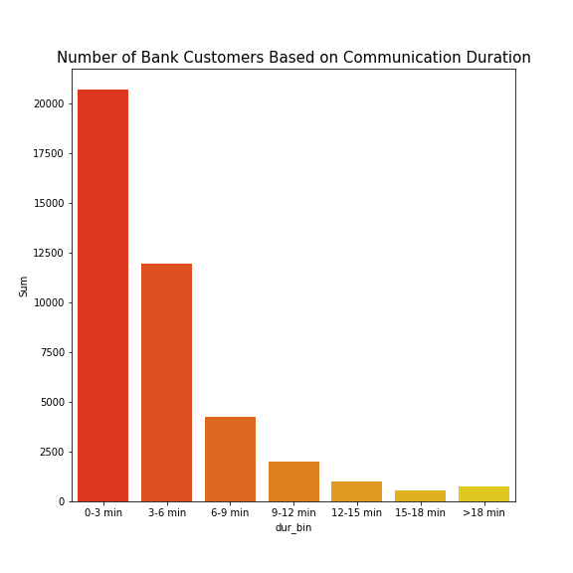
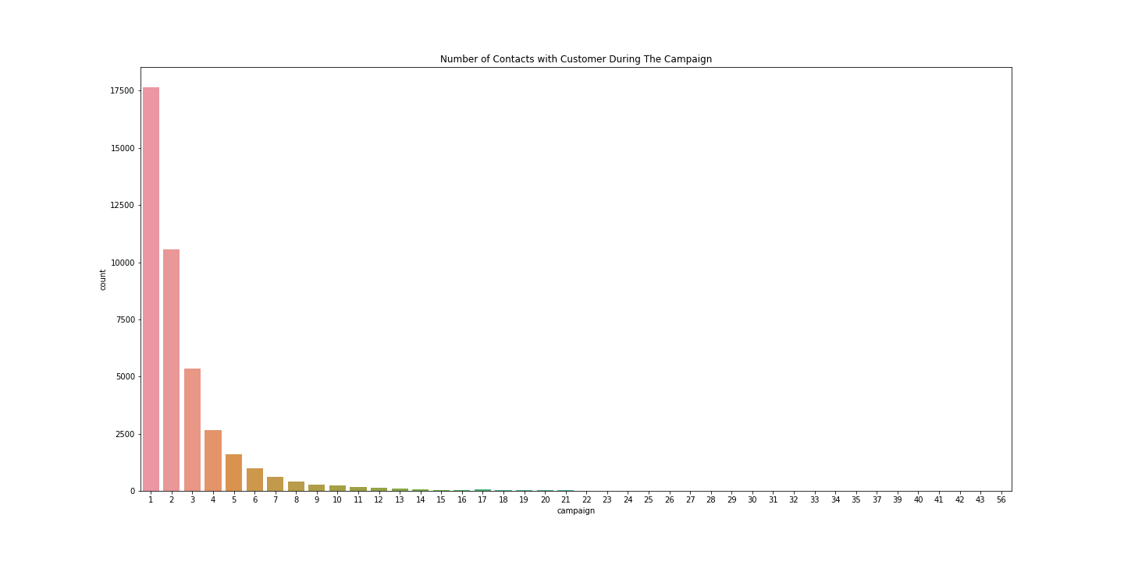
EDA – Univariate (6)
Most call durations are 0-3 mins and 3-6 mins
Most customers only contacted between 1 to 3 times during the campaign

Slide 20
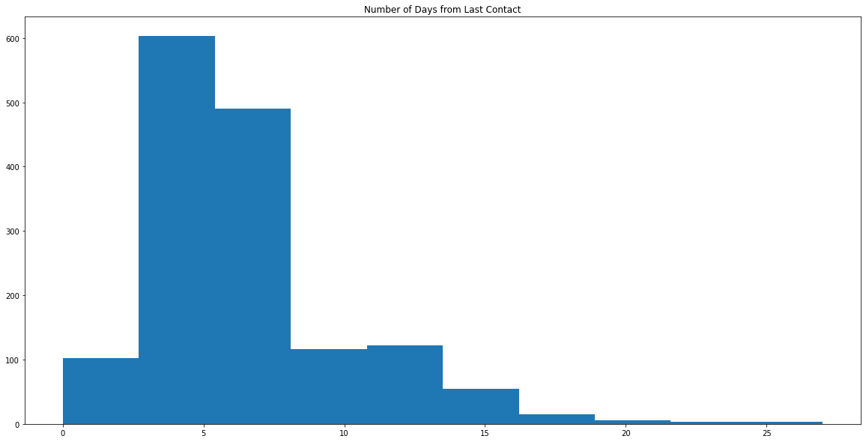
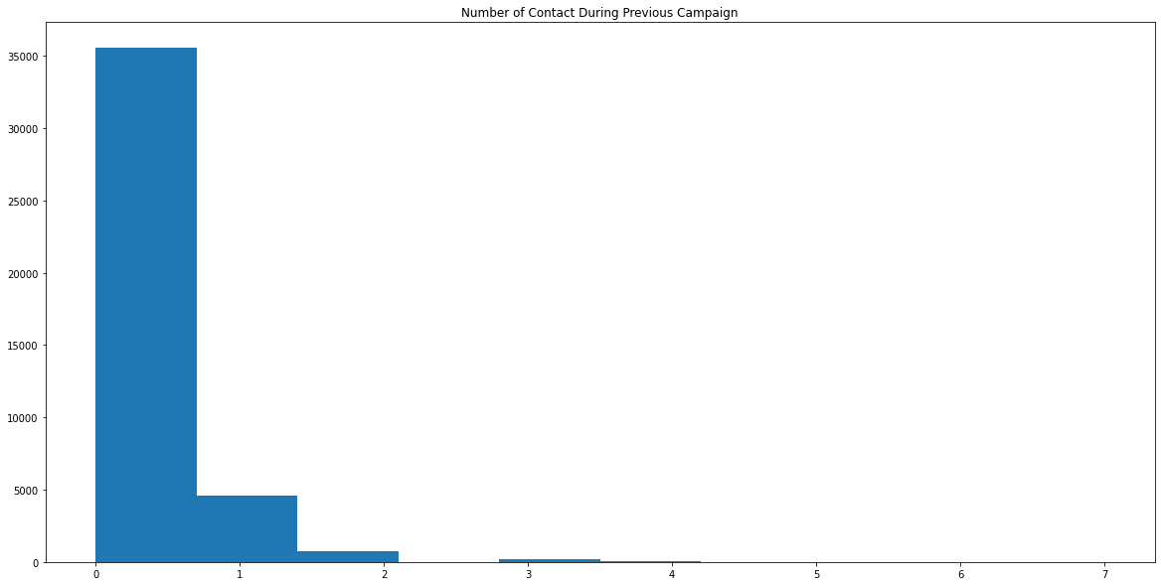
EDA – Univariate (7)
Most call customers are contacted again in 10 days
Most customers only contacted between 1 to 2 times during the previous campaign

Slide 21
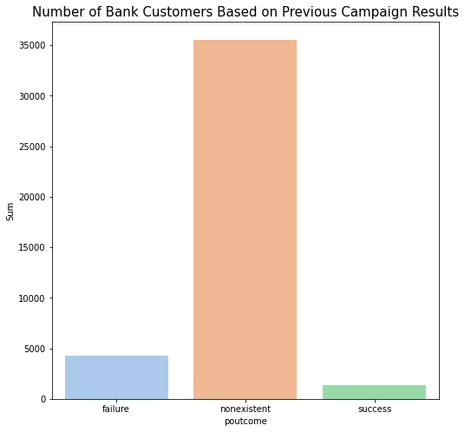
EDA – Univariate (8)
Most customers were not included in previous campaign and have nonexistent results

Slide 22
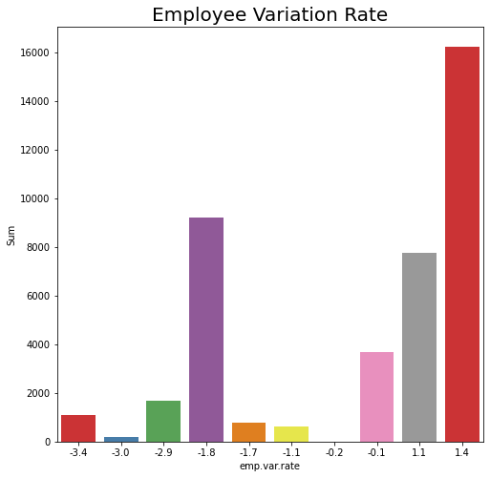
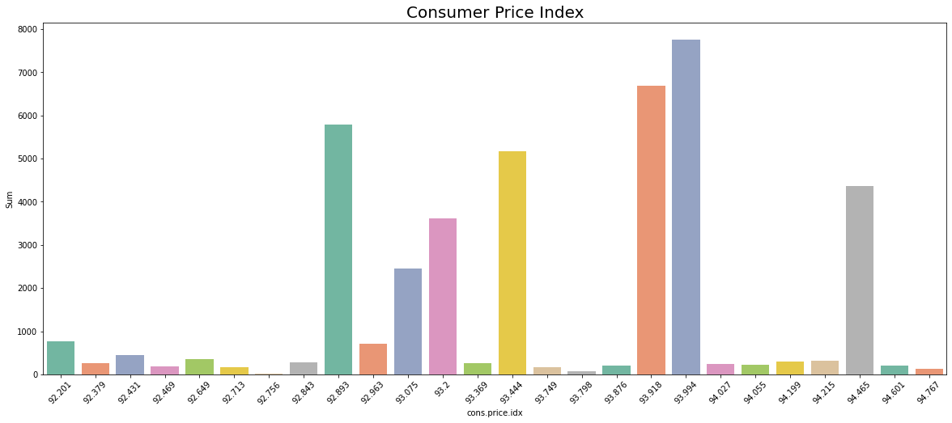
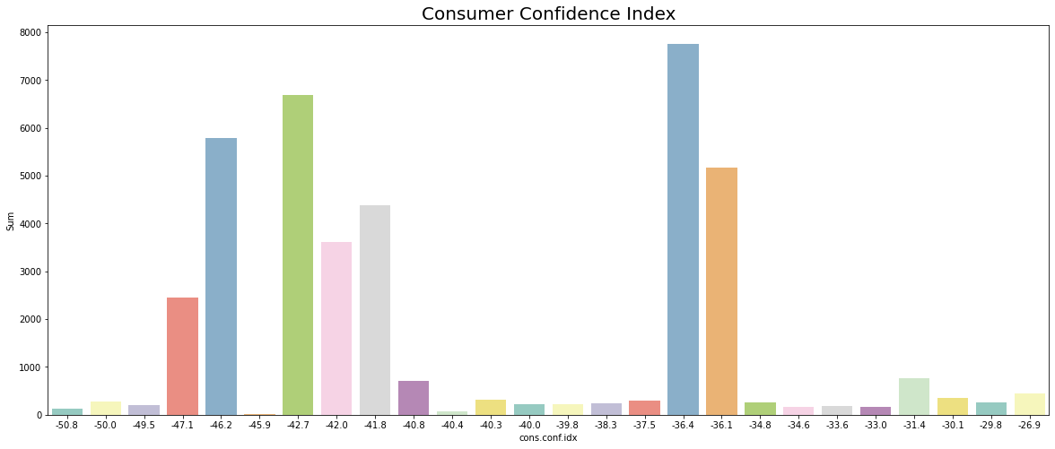
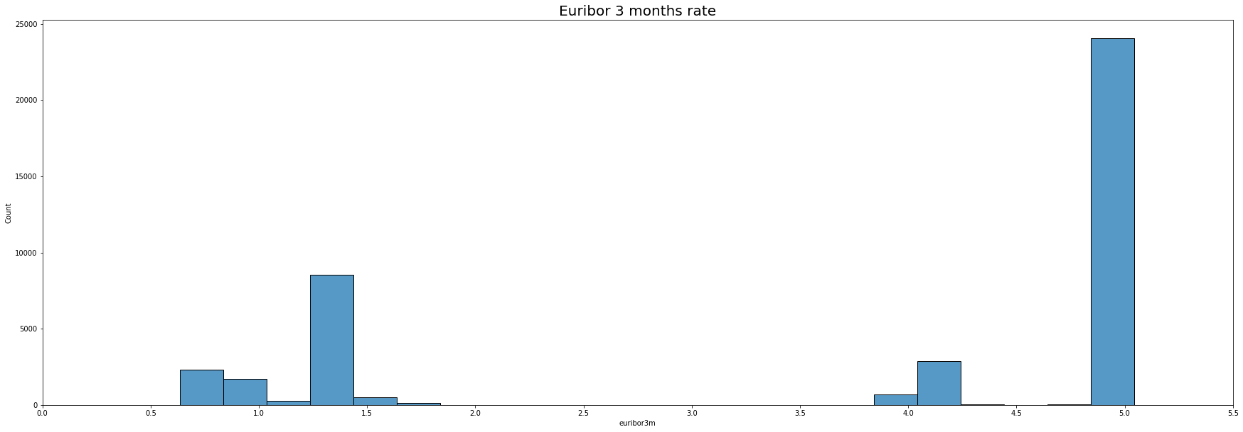
EDA – Univariate (9)

Slide 23
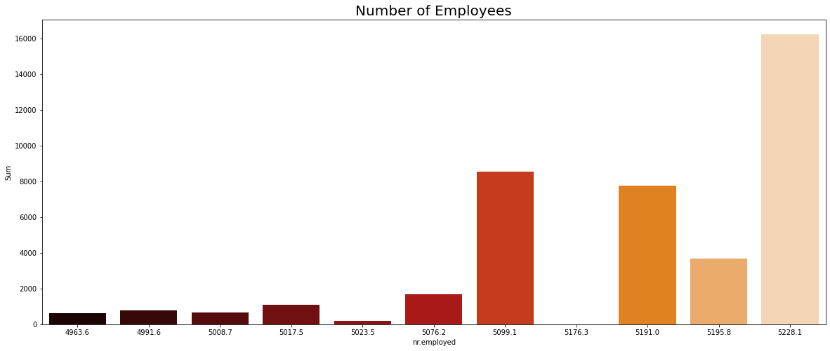
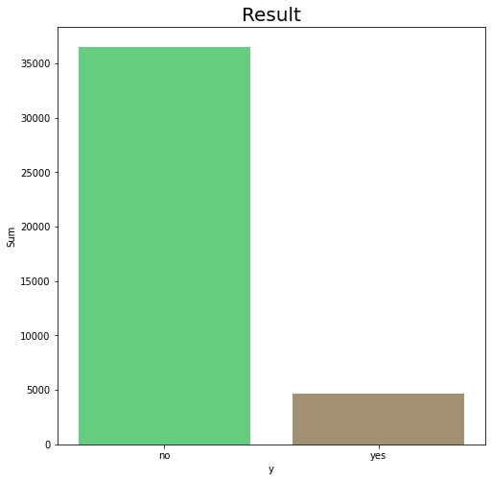
EDA – Univariate (10)
Most call customers were contacted when number of employees were high
Most didn’t subscribe to term deposit offered

Slide 24
Modelling
Tunjukkan table Perbandingan precision
Pk model apa aja
Kesimpulan
Grafik predict proba

Slide 25
Simulasi
Tunjukkan asumsi yang dipakai
Perhitungan
Kesimpulan (cost berkurang brp)

Slide 26
Conclusion
Menjawab Business Goalss

